Slide 1
Modeling Natural (M) and Fishing (F) Mortality in Stock Synthesis

Slide 2
M options in Stock Synthesis v3
Single value for all ages
Broken stick (piecewise linear) where the number of breakpoints can be set
Scaled Lorenzen curve where the curve is scaled to an estimable value at a given age
Age-specific vector of user-specified fixed values
Age- and time-specific by using environmental link

Slide 3
Broken stick

Slide 4
Broken stick
Age zero
Zero exponential offset

Slide 5
More on Mortality
Value for males offset from females
Can be time-varying like other parameters
If broken stick is used (piecewise linear), values before and after range of breakpoints are constant at first/last value

Slide 6
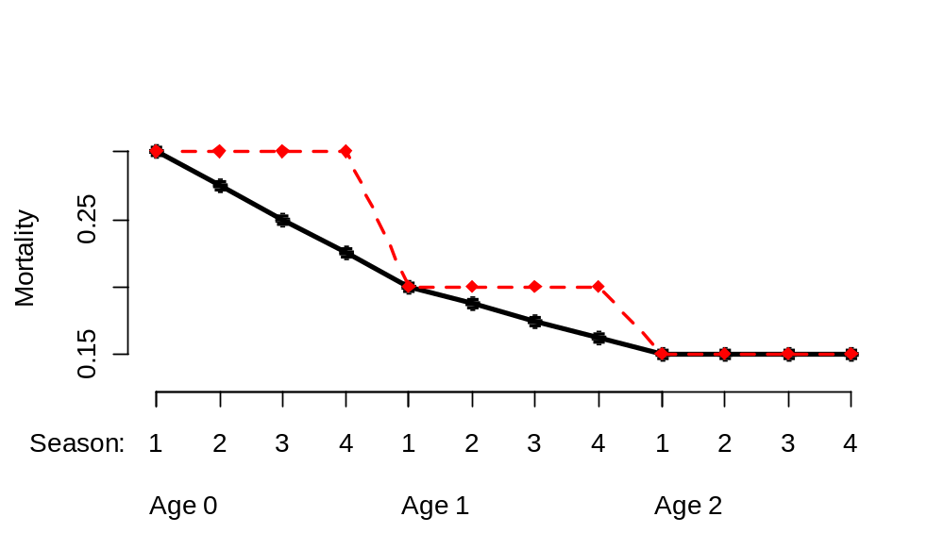
Mortality in seasonal models
Mortality is function of real age based on birth season, not calendar age
User-specified values have choice of same value for each season within year, or interpolated values for each season

Slide 7
Lorenzen mortality
Mortality is a function of mean size at age
Parameter for M at user-specified reference age
Based on initial growth curve, so does not work well with time-varying growth

Slide 8
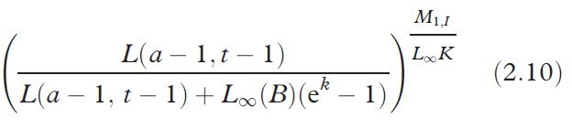
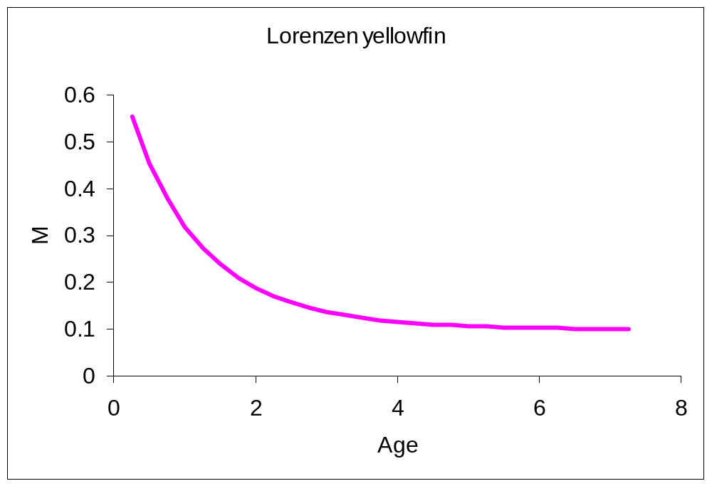
Lorenzen mortality
S =
Lorenzen, K. (2005) Population dynamics and potential of fisheries stock enhancement: practical theory for assessment and policy analysis. Philosophical Transactions of the Royal Society Series B, 360:171-189.

Slide 9
Fishing mortality (F)

Slide 10
Continuous F vs. Pope’s Approx.
With Pope’s
  Decays N-at-age to midyear using M
  Removes catch instantaneously using Hrate and selectivity, with Hrate calculated to exactly match the observed landed catch
  Decays fishery survivors to end or year using M
  Survey timing allows a specified fraction of M and catch to occur before the survey
  New option now allows sampled agecomp to equal catch agecomp
With continuous F
  Uses M + F to calculate Z at age
  Uses Z to decay N-at-age to time of survey
  Implications of selectivity differ between the two approaches

Slide 11
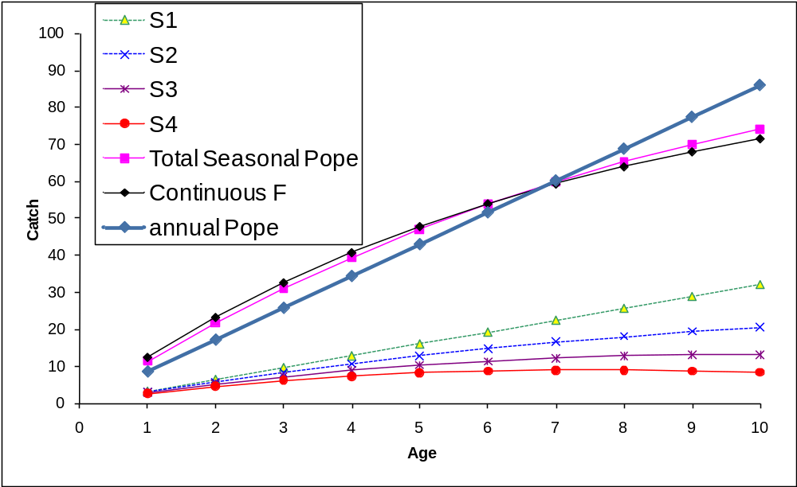
Selectivity issue
With N-at-age constant (100) and linear ramp in selectivity, we need multiple seasons for Pope’s to approximate continuous F if F is high (here, 1.8)

Slide 12
Hybrid F
Start by doing a Pope’s calculation of mid-season exploitation rate:
Hrate = catch_ret_obs(f,t)/vbio
Then convert to an estimate of equivalent F
F=-log(1.-Hrate);
Then tune the F values in a fixed number (3-5) of iterations to approximate the observed catch

Slide 13
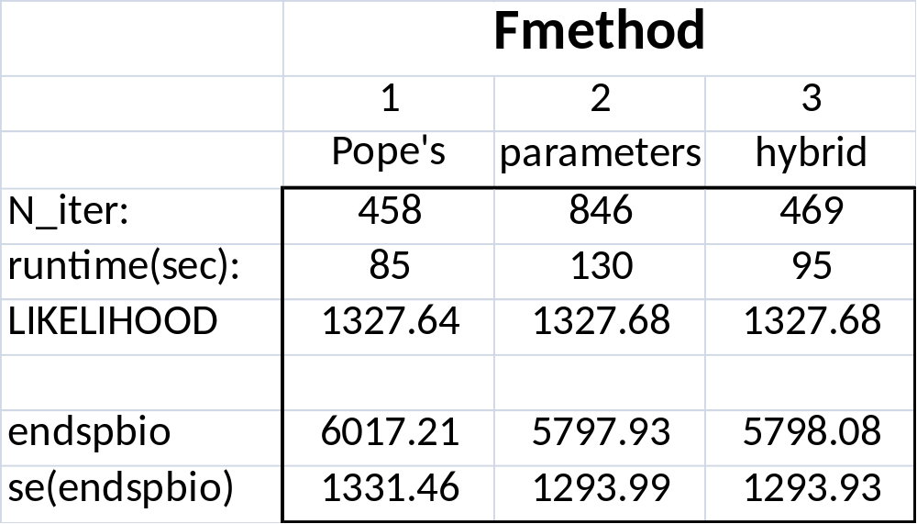
Hybrid F comparison

Slide 14
Reporting total F
The complexities of multiple fleets, areas, growth patterns, seasons, dome-selectivity, etc. wreck havoc with calculation of a single annual total “F” statistic
Initially, SS focused on reporting an annual value for equilibrium SPR and the total exploitation rate (catch/summary biomass).
Sum of the apical F values across fleets is also available, but it is easily misleading in complex setups.
New option gets age-specific total F from Z-M, where:
  Z=ln(N_{t+1,a+1} / N_{t,a}) on annual not seasonal basis, and
  M=ln(N_{t+1,a+1} / N_{t,a}) with fishery turned off
With the fishery on and then off, SS reports:
  Spawning biomass by area and GP
  Numbers at age by GP and gender (combines areas)
  Z at age by GP and gender
  Up to output processors to do the F=Z-M calculations

